Slide 1
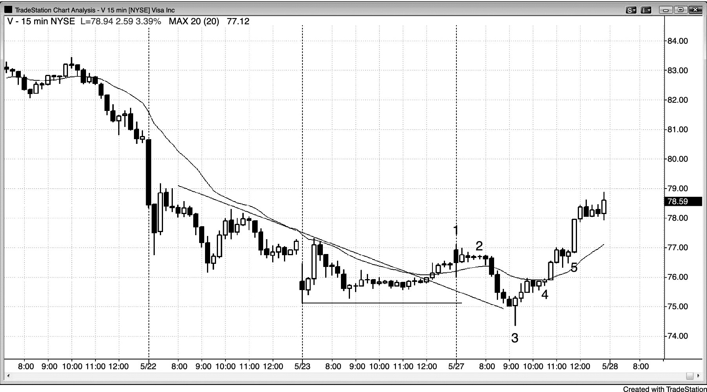
FIGURE 4.1 A Typical Buy Signal Bar

